Slide 1



Chaotic MEMS-based TRNG
Martial Defoort
with Libor Rufer, Laurent Fesquet, Skandar Basrour
Univ. Grenoble Alpes, CNRS, Grenoble INP, TIMA

Slide 2
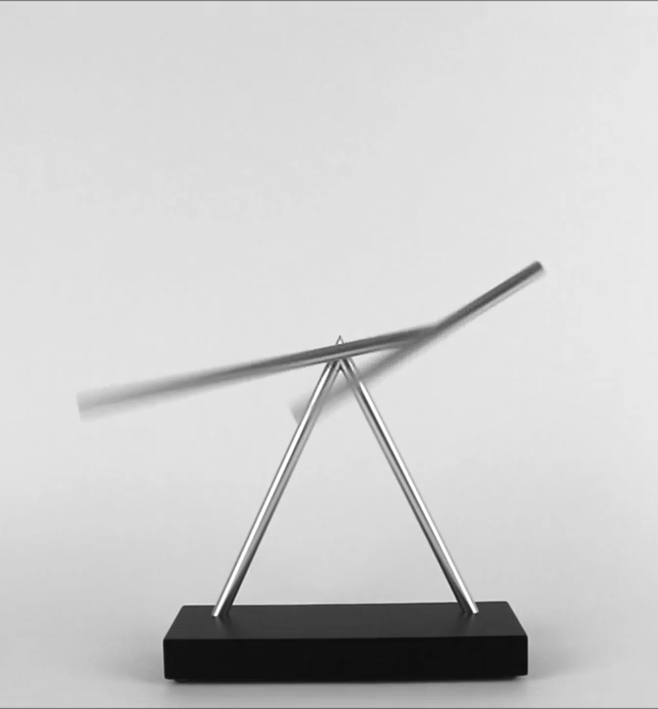
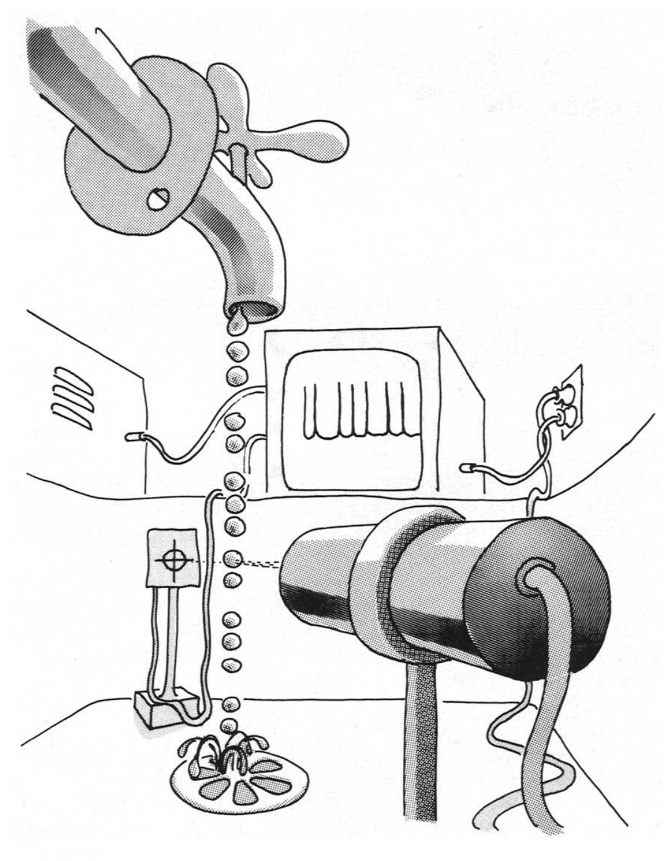
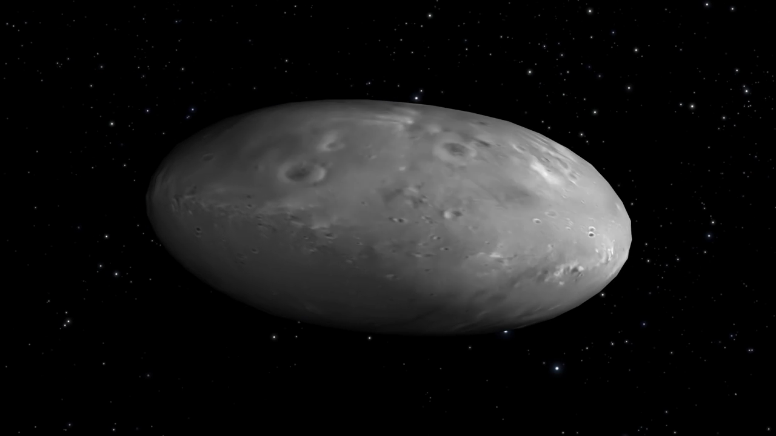
Chaos: Where ? Why ?
Pluto’s moon Nix
The Swinging Sticks
Dripping faucet
nasa.gov
GeelongShop.com
P. Martien et al, Physics Letters (1985)
Chaotic regime:
  Complex interactions within at least 3 DoF
  Non-periodic yet deterministic
  Exponentially sensitive to initial conditions

Slide 3
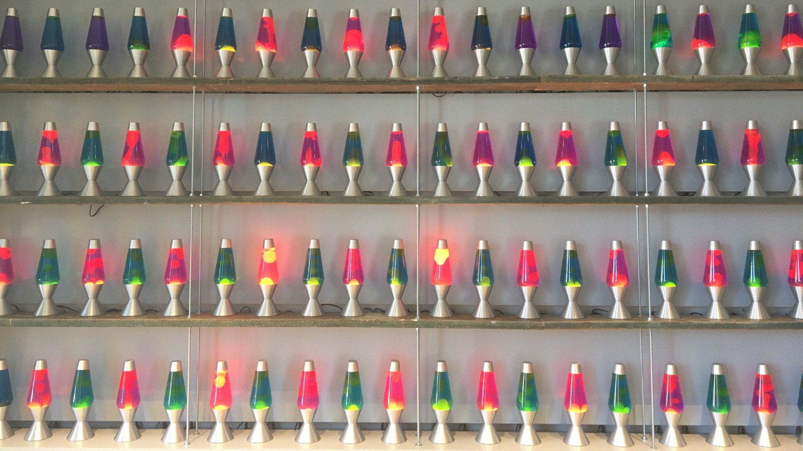
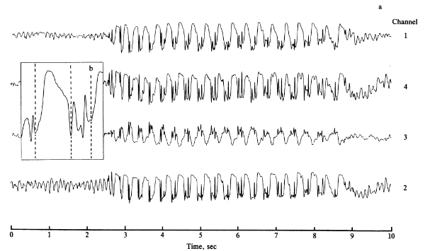
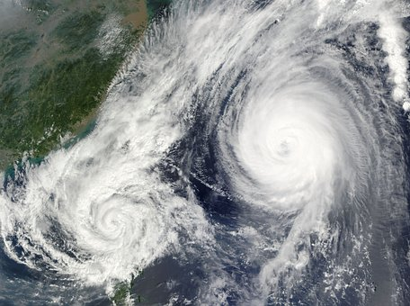
Chaos: What for ?
Random numbers
Epileptic seizure
Cloudflare
Weather
A. Babloyantz et al, PNAS (1986)

Slide 4
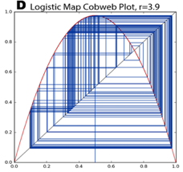
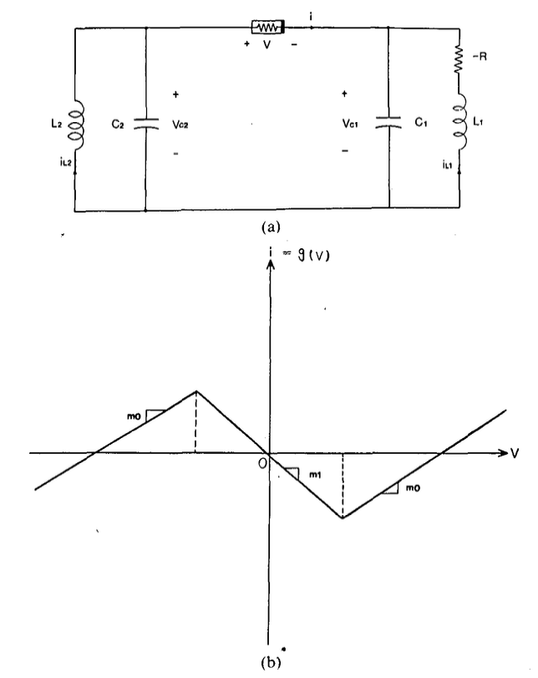


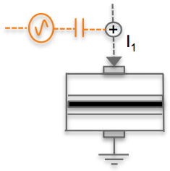
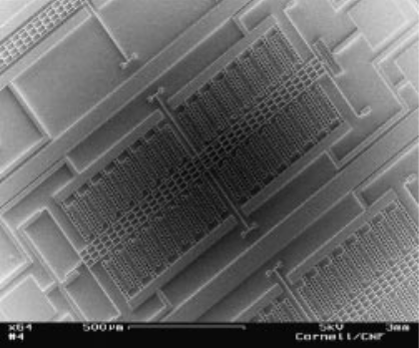
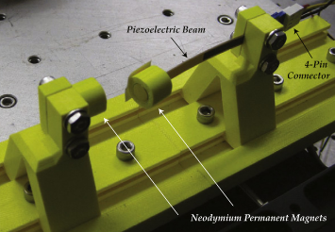
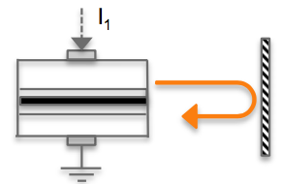

Tailoring chaos
Mathematically
Electronically
The logistic map
Chua circuits
with
Nonlinear resistance
Boeing, PhD (2017)
Matsumoto, IEEE TCS (1986)
Optically
Mechanically
Optical feedback
Current modulation
Buckled structures
State of the art in MEMS: capacitive control
Miandoab et al, CNSNS (2015)
Barcelò et al, MEMS (2018)
V_{DC}
Active buckling :
10-100 V continuous
Time (ms)
Sciamanna, Nature Photonics (2015)
Wang, IEEE TCS (1998)
Stanton, Physica (2010)

Slide 5
Chaotic MEMS-based TRNG
Martial Defoort
with Libor Rufer, Laurent Fesquet, Skandar Basrour
Univ. Grenoble Alpes, CNRS, Grenoble INP, TIMA

Slide 6
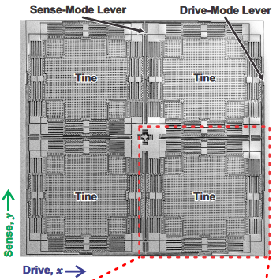
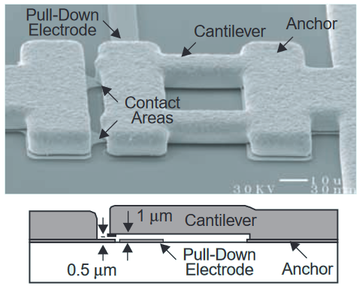
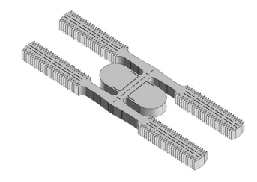
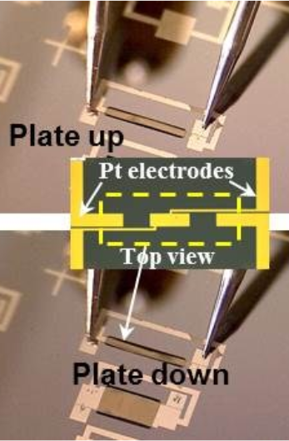
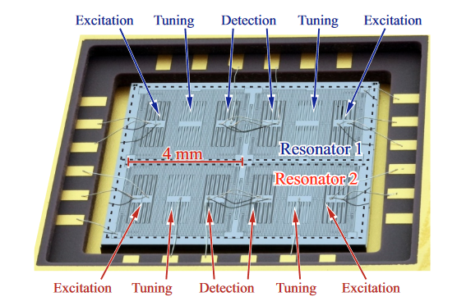
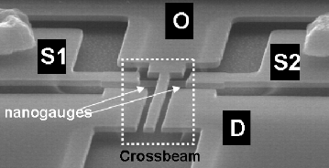
Micro-ElectroMechanical Systems
Non-resonant
Resonant
RF switches
Gyroscopes
Clocks
SiTime, (2017)
Analog Devices, (2001)
I.P. Prikhodko et al,
Solid State Sensors (2011)
Energy Harvesters
Gas sensors
Accelerometers
E. Trioux,
IEEE Sensors (2014)
S. A. Zotov,
IEEE Sensors (2015)
J. Arcamone, IEDM (2011)

Slide 7
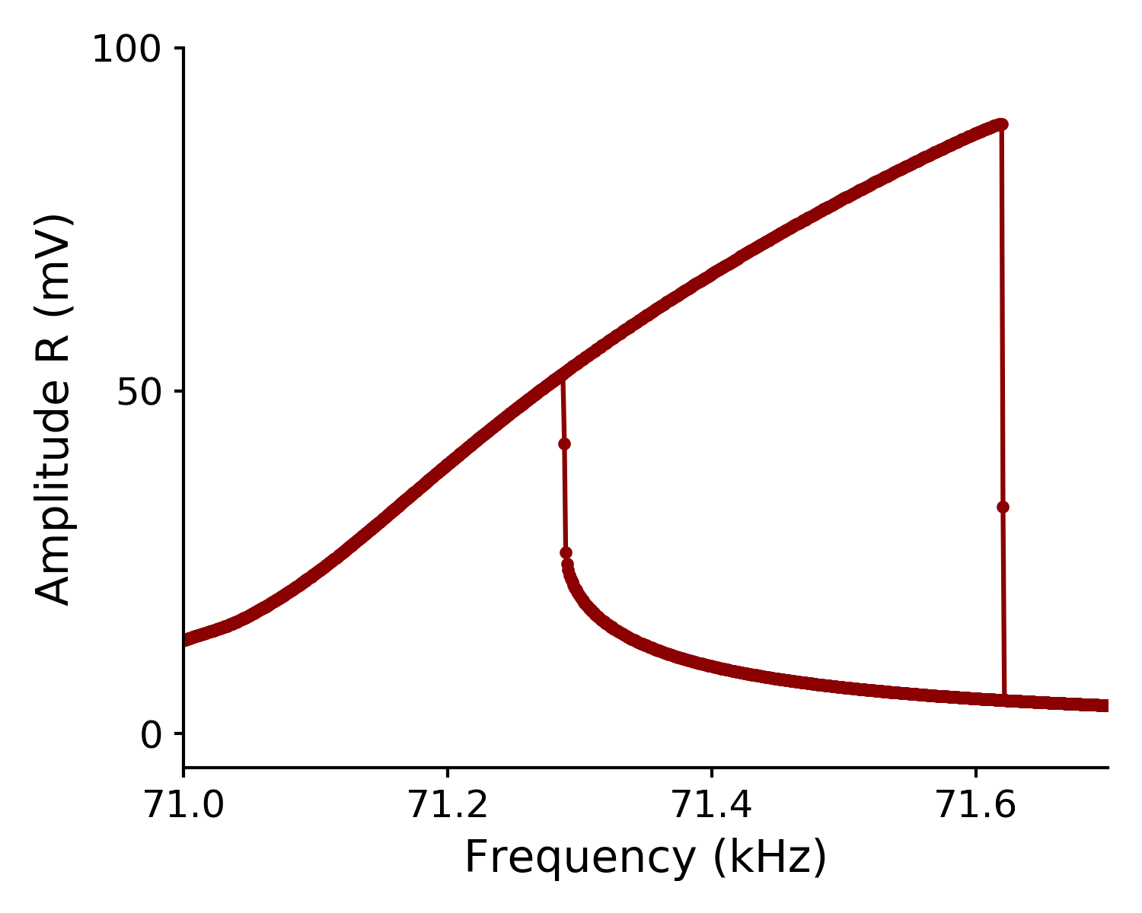


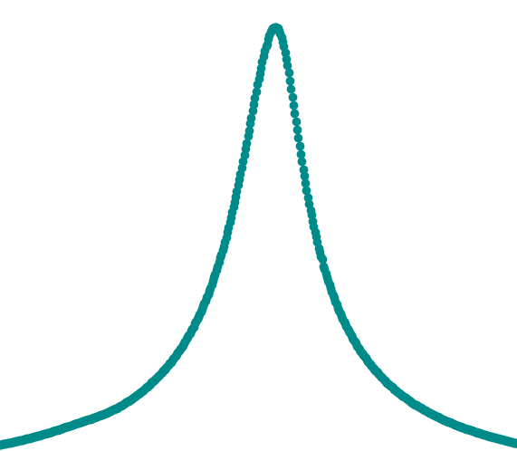



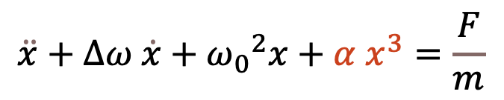
Nonlinear mechanics
$$\ddot{x}+∆ω \dot{x}+{ω_{0}}^{2}x+α x^{3}=\frac{F}{m}$$
α Amp²
F_{AC}
Amplitude (a.u.)
F_{AC}
Frequency (a.u.)
Dynamical bistability available in most MEMS resonators

Slide 8


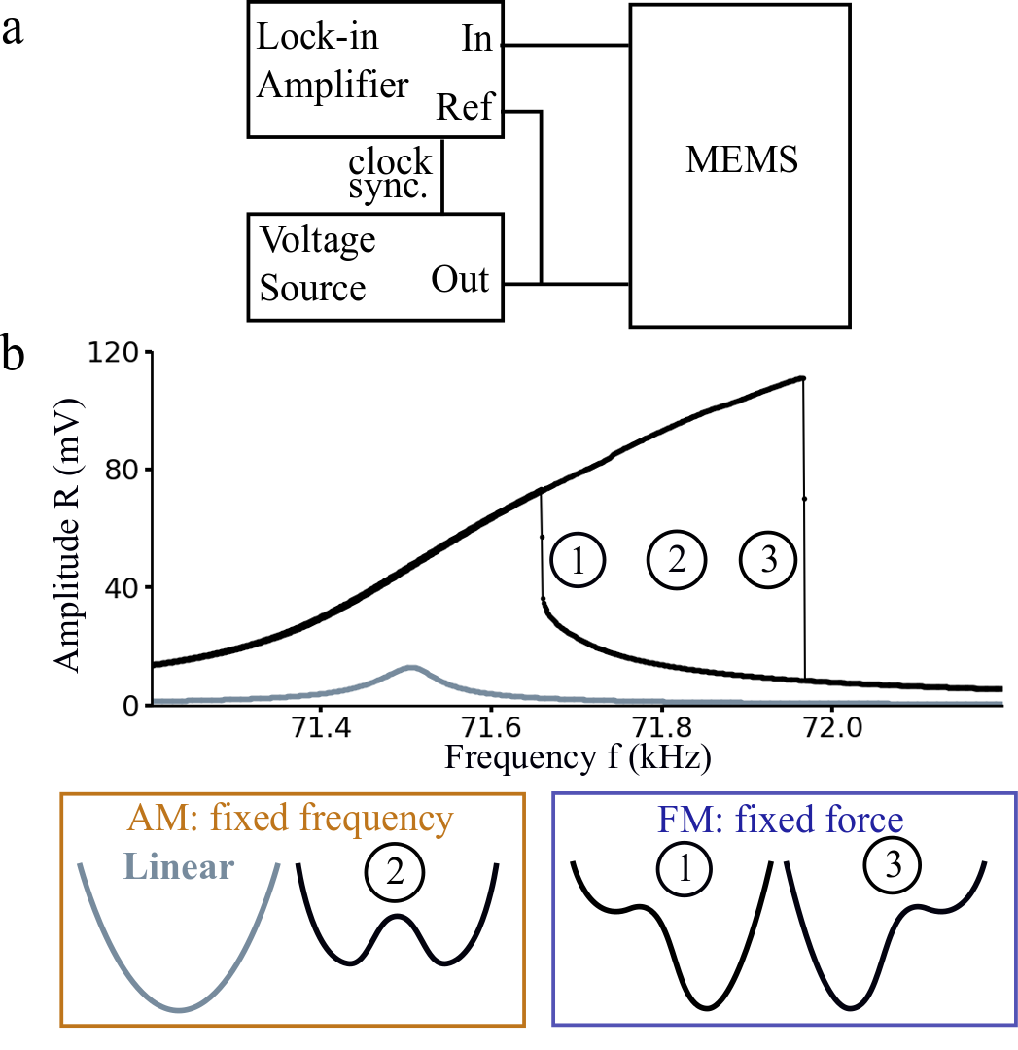
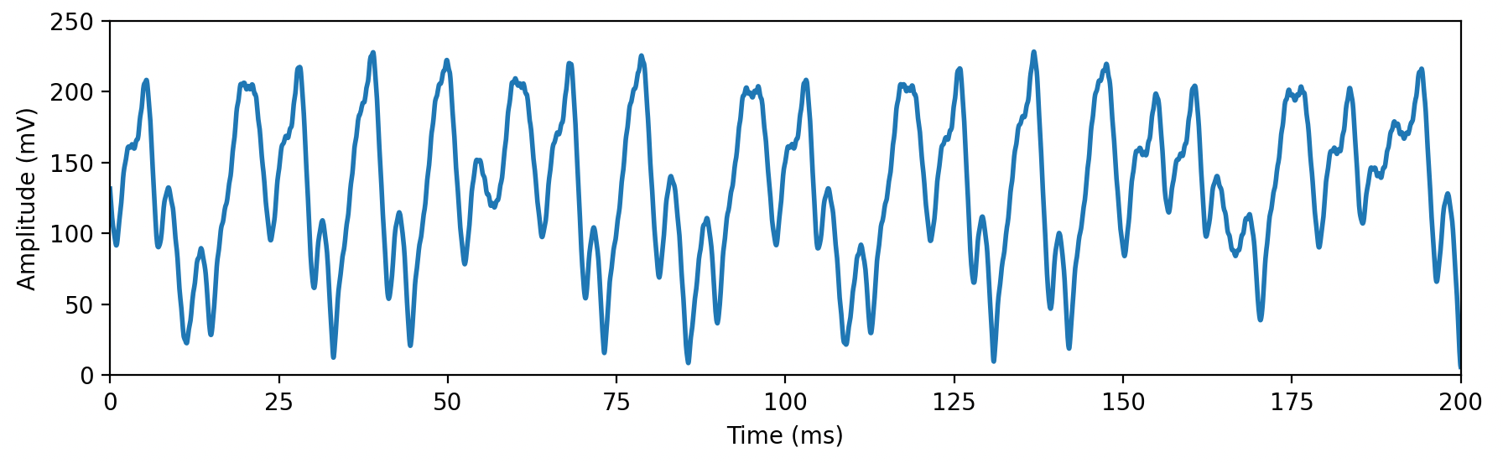

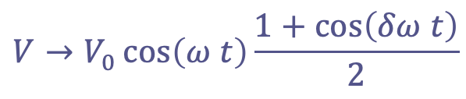

Modulation in a nonlinear membrane
Setup
⌀ 1500 µm
Si: 10 µm
AlN: 500 nm
f₀ = 71.5 kHz Q = 1100 @ 1mbar
FM
FM
AM
Chaos:
non-periodic
non-reproducible
How do we study it ?
AM
Normal:
$$V→V_{0}\cos\left(ω t\right)$$
FM:
$$V→V_{0}\cos\left(ω t+\sin\left(δω t\right)\right)$$
AM: fixed frequency
FM: fixed drive
$$V→V_{0}\cos\left(ω t\right)\frac{1+\cos\left(δω t\right)}{2}$$
AM:
Fast modulation system never at equilibrium new physics

Slide 9
Chaotic MEMS-based TRNG
Martial Defoort
with Libor Rufer, Laurent Fesquet, Skandar Basrour
Univ. Grenoble Alpes, CNRS, Grenoble INP, TIMA

Slide 10
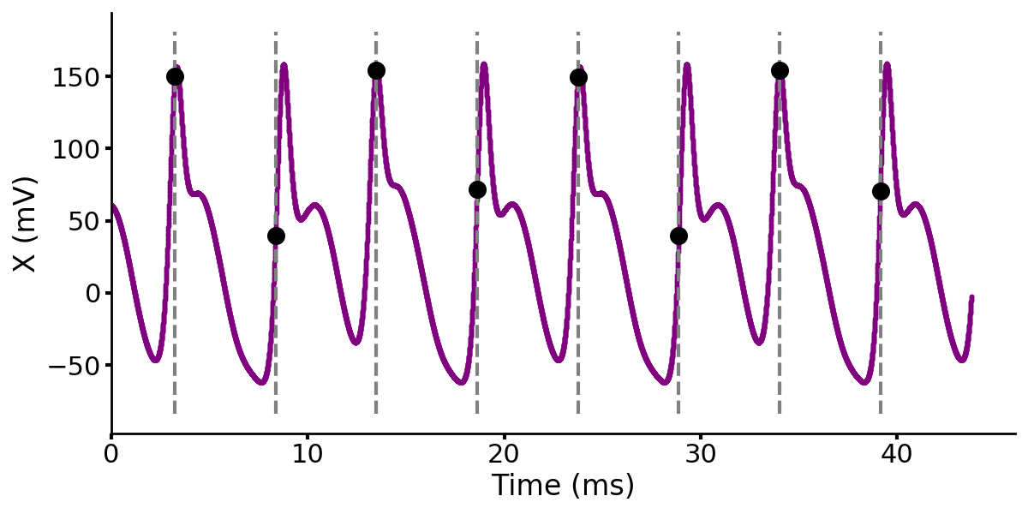
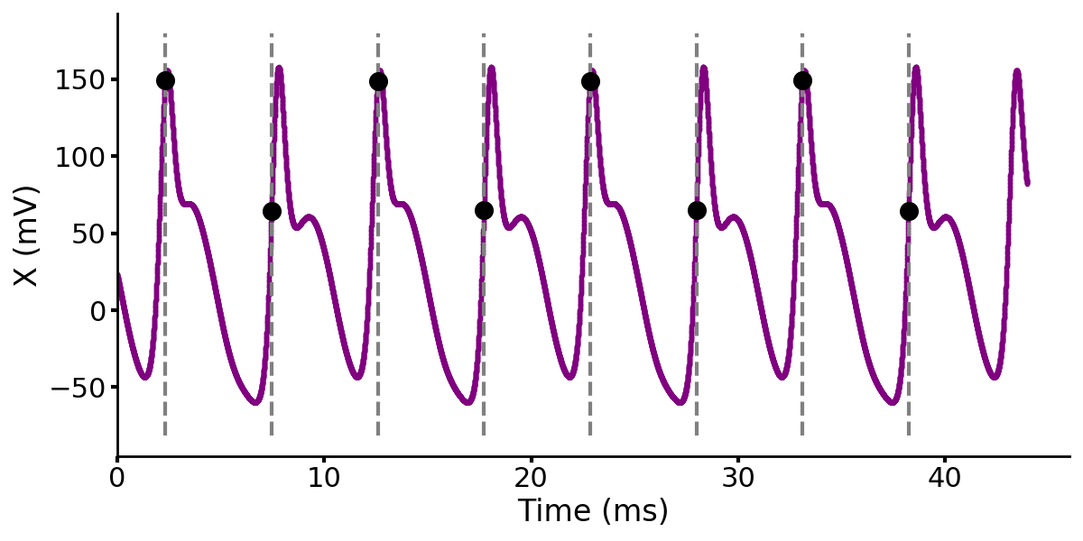
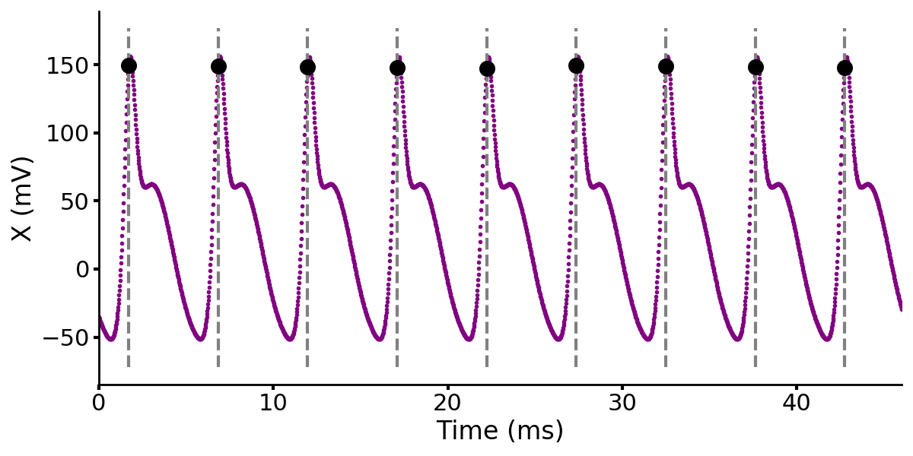
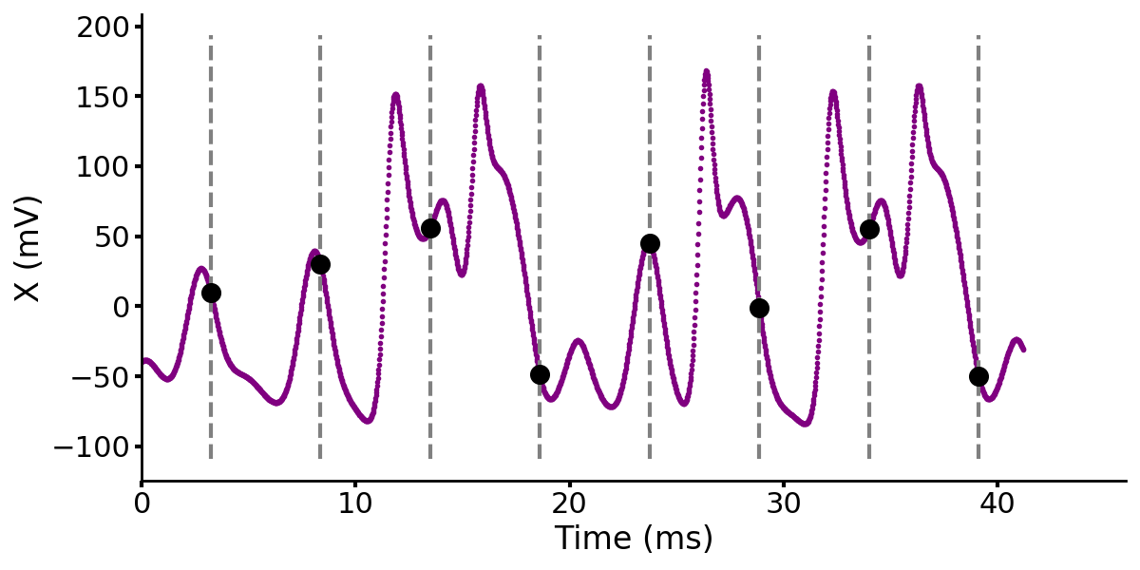
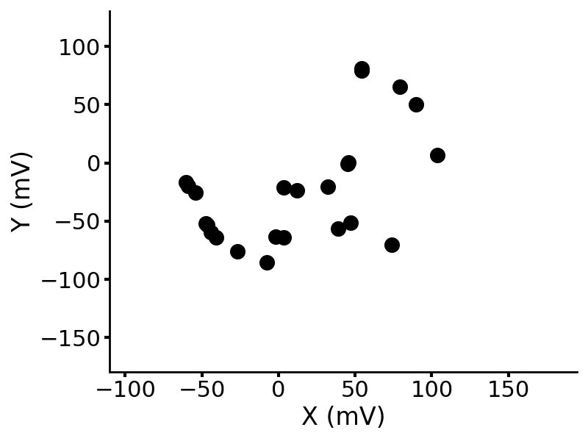
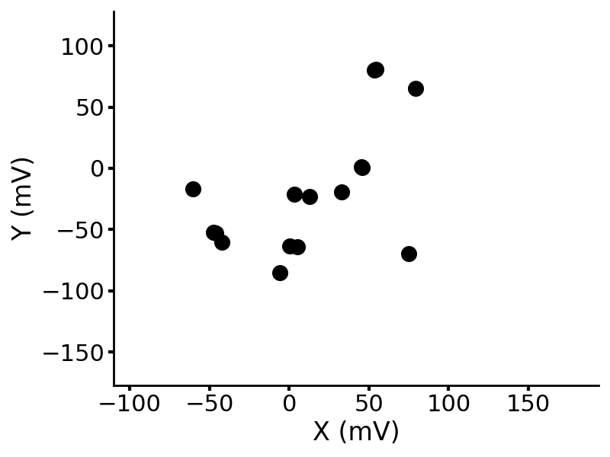
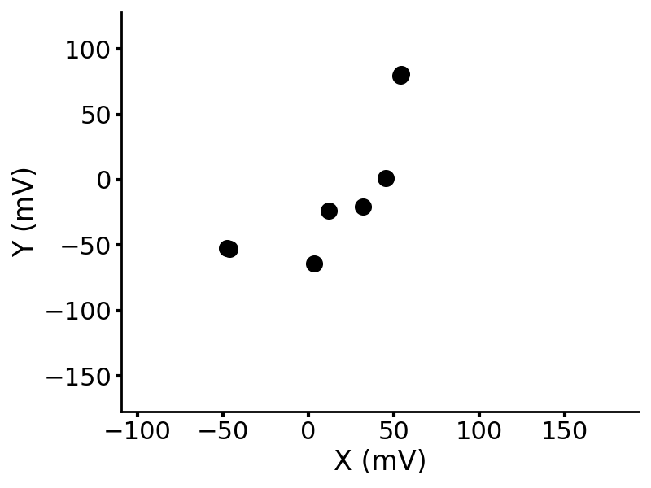
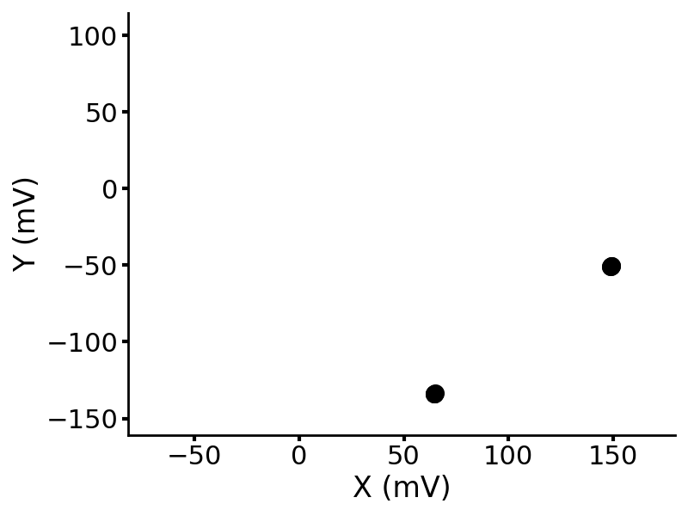
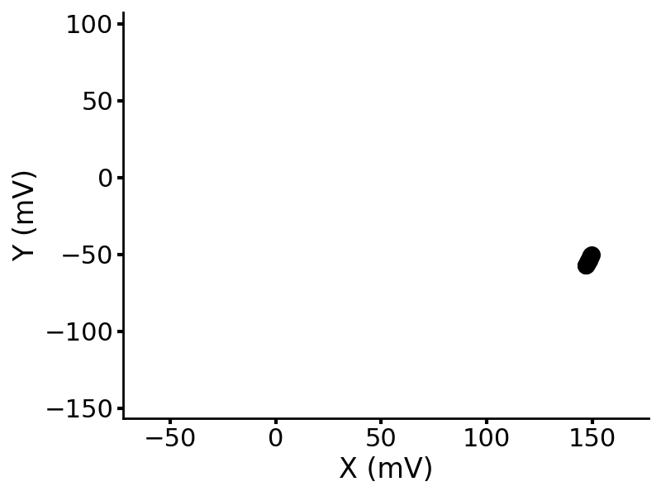
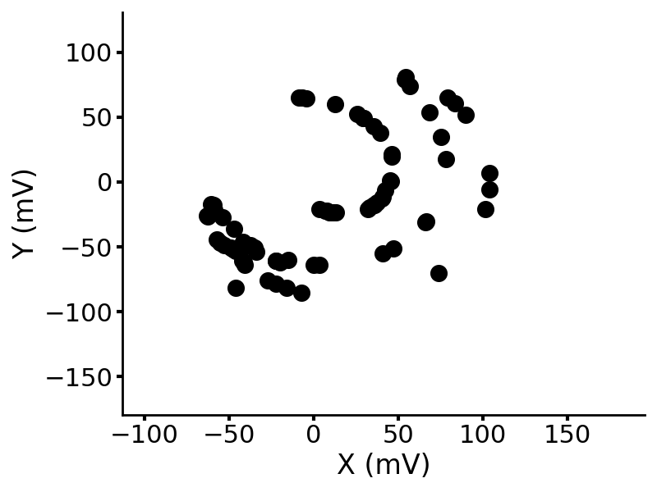
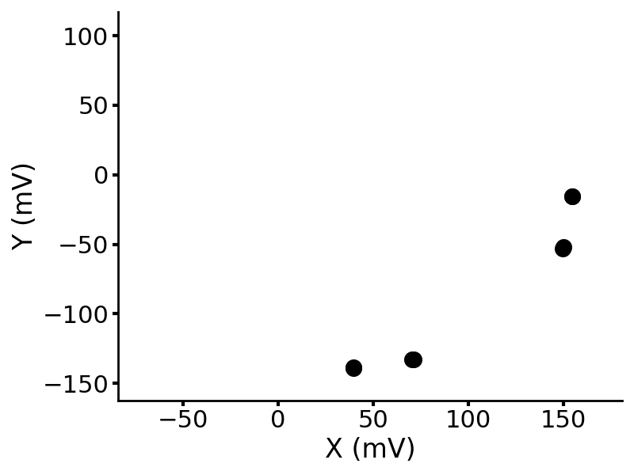
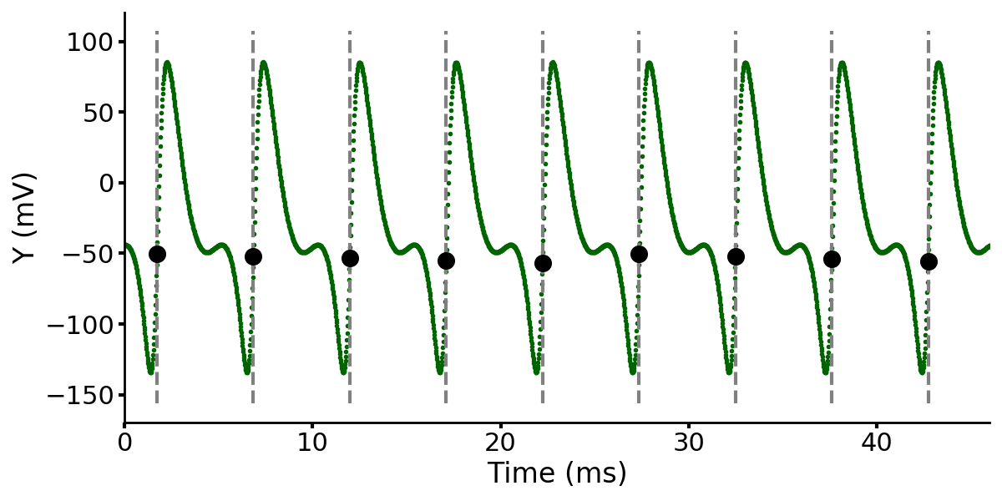
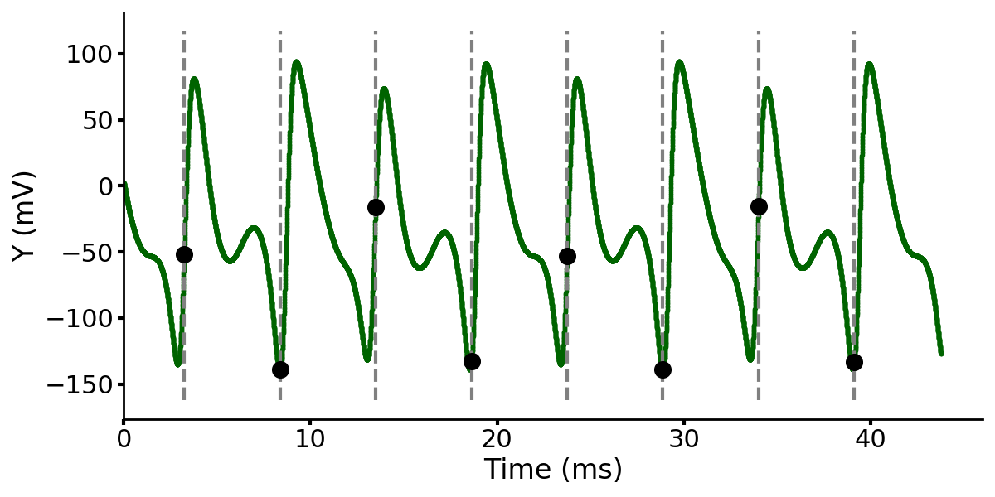
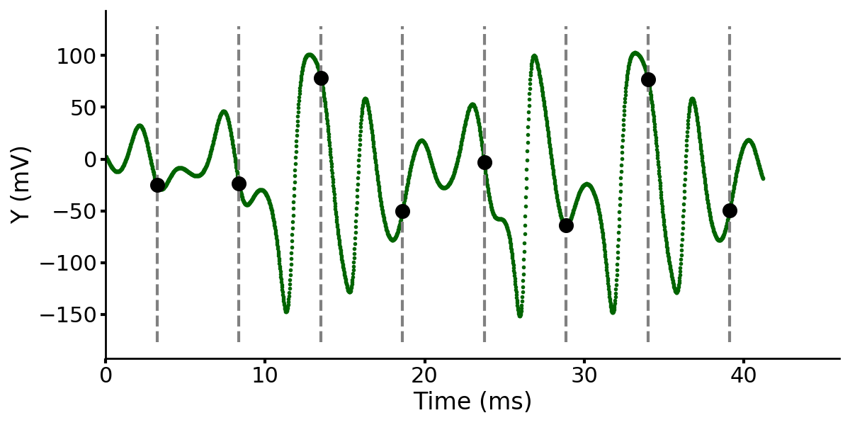
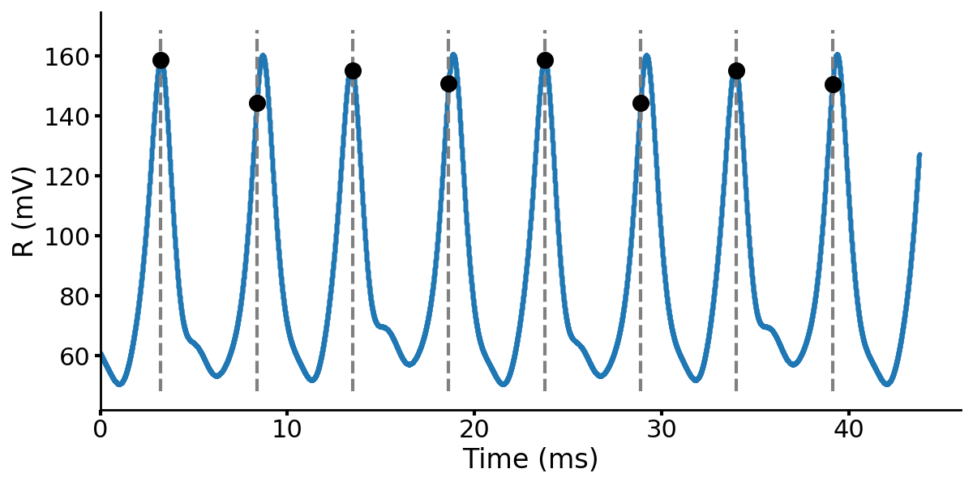
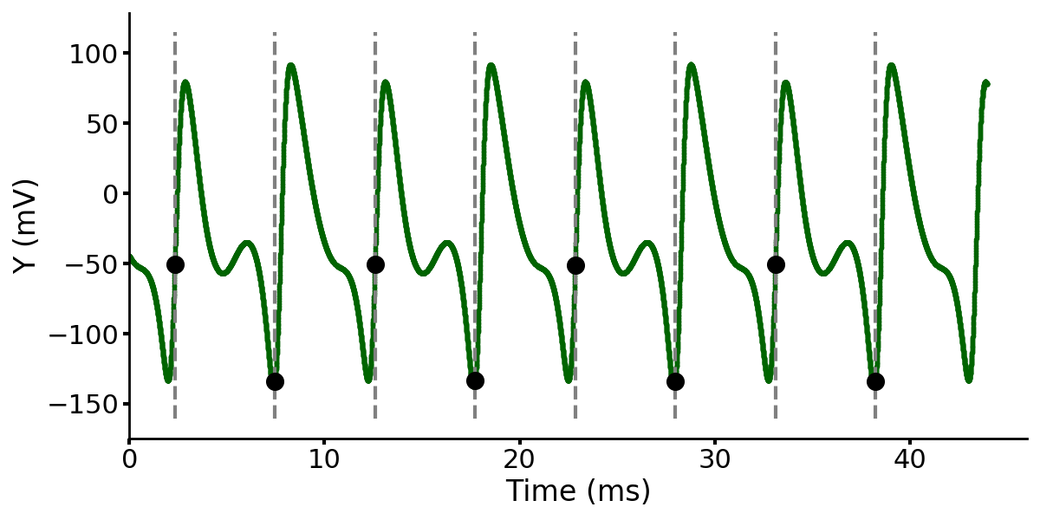
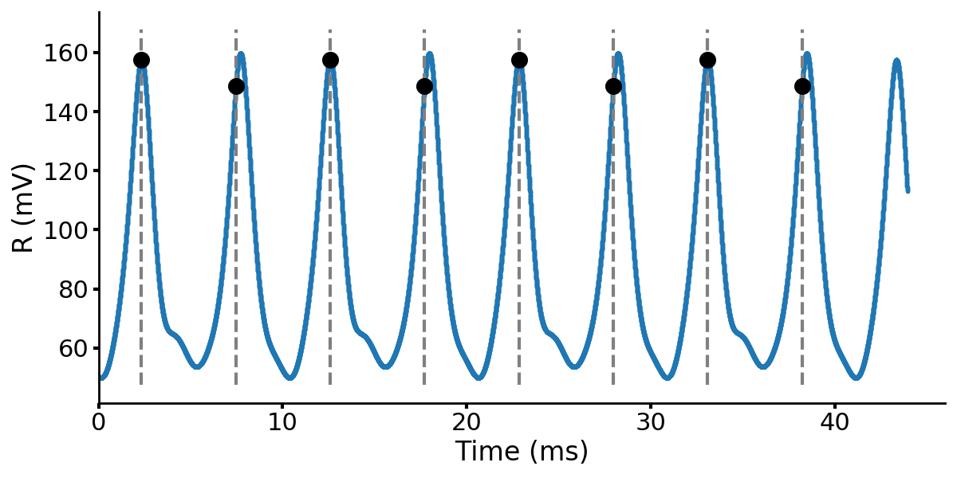
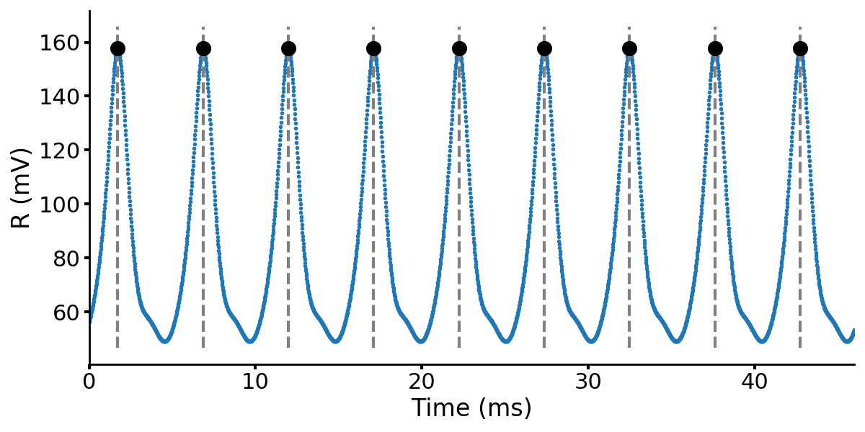
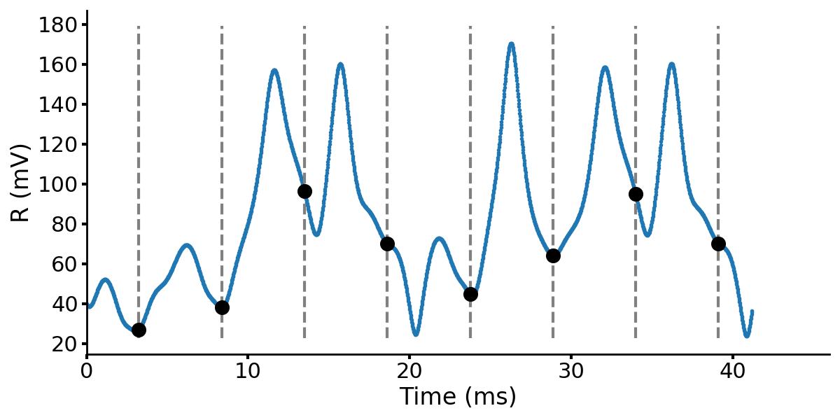
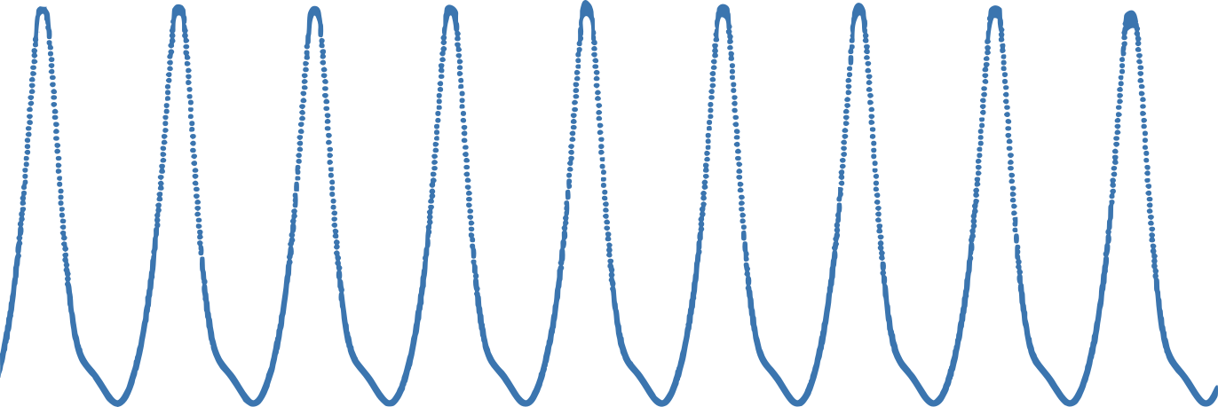

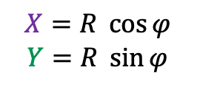
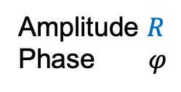
The phase state plane
Amplitude $R$
Phase $φ$
$X=R \cos{φ}$
$$Y=R \sin{φ}$$
Resonator:
with more…
AM
more…
more!
Amplitude (a.u.)
1/$δ$f
Frequency (a.u.)
Poincaré sections: order within chaos

Slide 11
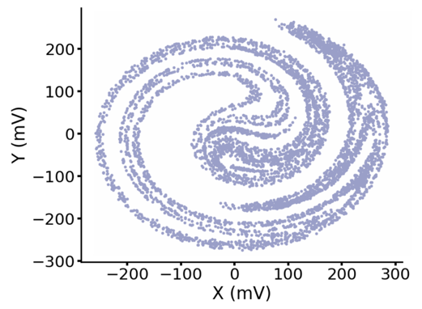
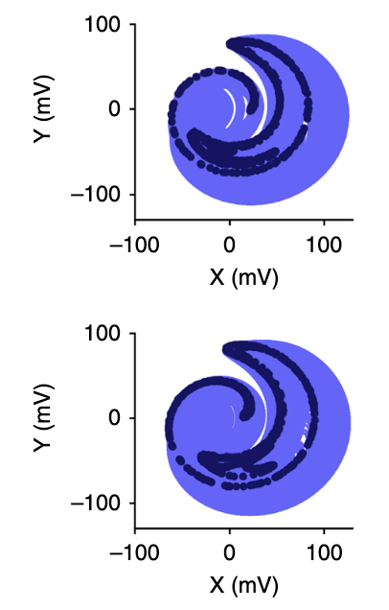
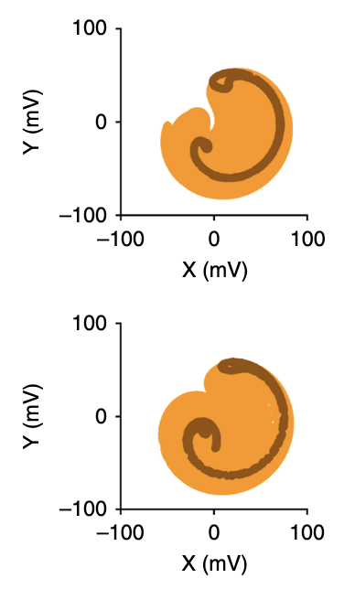
Poincaré sections
Amplitude
Modulation
Frequency
Modulation
Experimental
Numerical

Slide 12
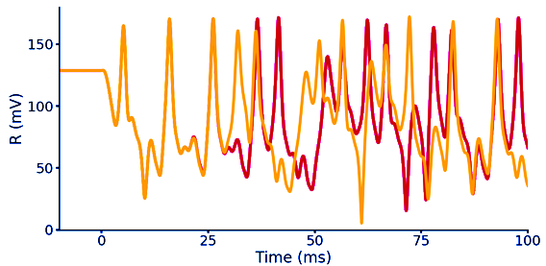





Sensitivity to initial conditions
$λ$: Lyapunov exponent
AM:
$$V→V_{0}\cos\left(ω t\right)\frac{1+\cos\left(δω t\right)}{2}$$

Slide 13




Lyapunov Exponents
Amplitude Modulation
Frequency Modulation
Experimental
Numerical

Slide 14

Concrete example of MEMS-based TRNG
3 Last Significant Bits of an 8-bit ADC
NIST 800-22 test on 75 Mb
with a rate of 15 kb/s
Test | p-Value | Proportion | Result
Frequency | 0.044425 | 75/75 | Pass
Block Frequency | 0.754127 | 73/75 | Pass
Cumulative Sums | 0.622341 | 150/150 | Pass
Runs | 0.099089 | 75/75 | Pass
Longest Run | 0.491599 | 75/75 | Pass
Rank | 0.666838 | 75/75 | Pass
FFT | 0.069925 | 74/75 | Pass
NOT Matching | 0.419859 | 11008/11100 | Pass
OT Matching | 0.009343 | 74/75 | Pass
Universal | 0.548605 | 74/75 | Pass
Approx. Entropy | 0.015444 | 74/75 | Pass
Random Excursion | 0.433207 | 371/376 | Pass
Random Exc. Var. | 0.393372 | 839/846 | Pass
Serial | 0.650162 | 150/150 | Pass
Linear Excursion | 0.256632 | 75/75 | Pass
XOR

Slide 15

Conclusion
Chaotic MEMS-based TRNG
Reachable and scalable with any vibrating MEMS
Experiments/simulations in quantitative agreement
Chaos-based TRNG
In-sensor computing (smartphones, cars, IoT)
Adaptable working point (aging, deterioration, …)
Any arbitrarly small stochasticity eventually
takes over the whole signal (mostly thermo)

